Slide 1
Natural Language Processing Specialization Recurrent Neural Networks for Language Modeling
(2021 Deeplearning.ai)
YangXi’s Reading Notes

Slide 2
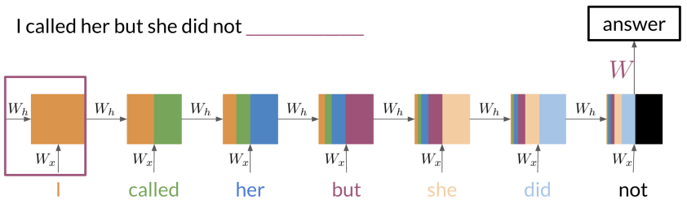
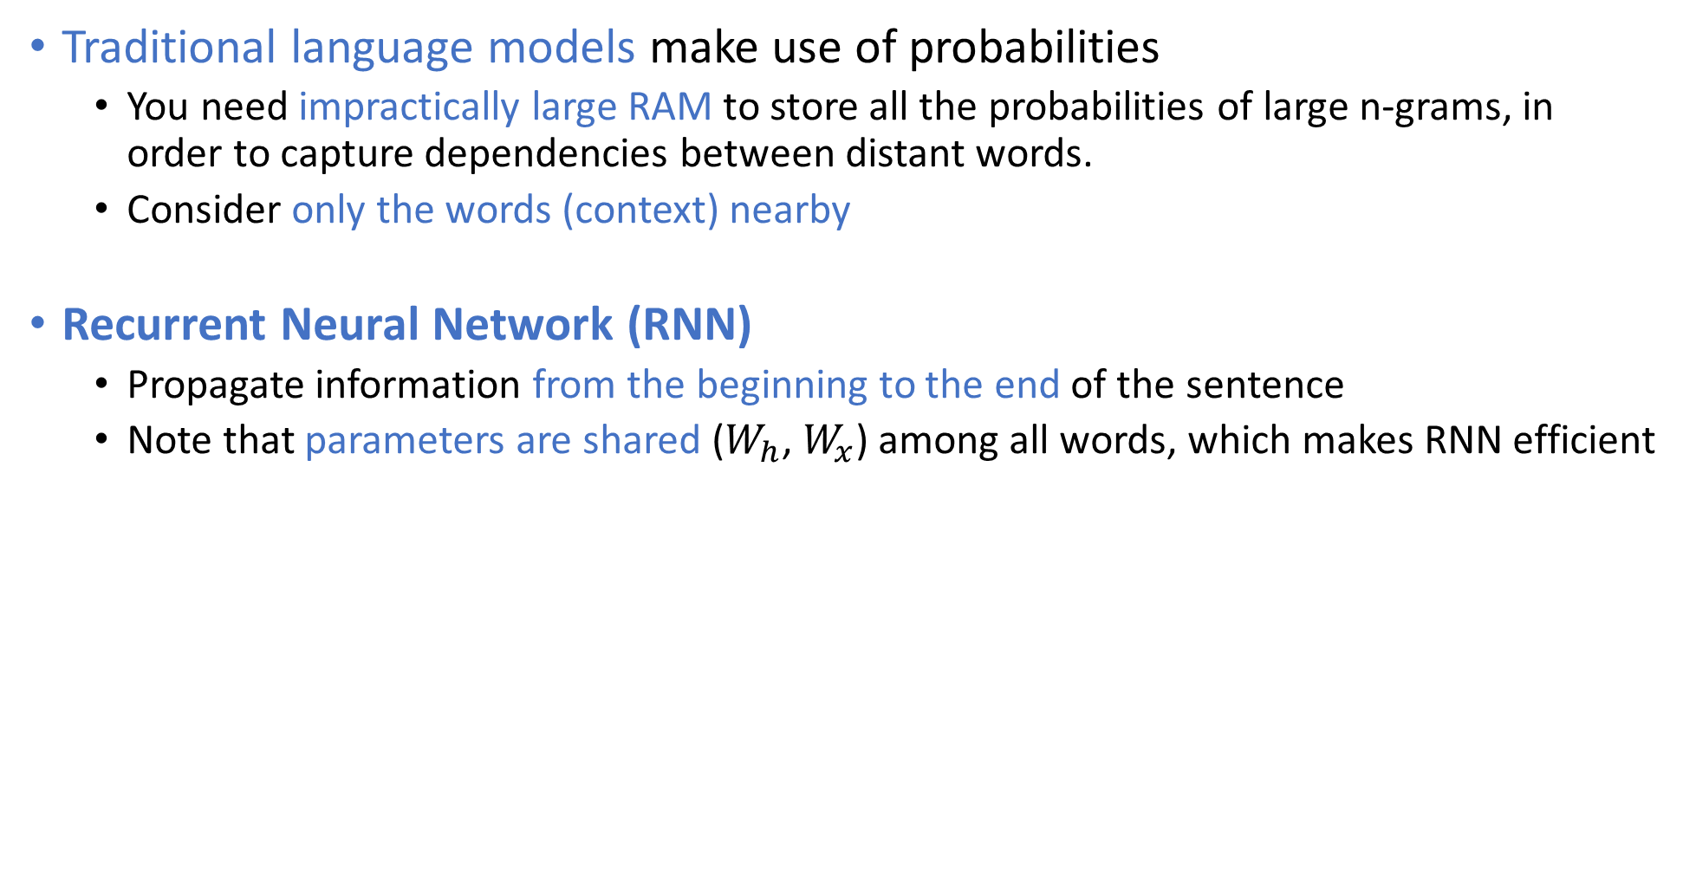
Traditional Language Models vs. RNN
Traditional language models make use of probabilities
You need impractically large RAM to store all the probabilities of large n-grams, in order to capture dependencies between distant words.
Consider only the words (context) nearby
Recurrent Neural Network (RNN)
Propagate information from the beginning to the end of the sentence
Note that parameters are shared ($W_{h}$, $W_{x}$) among all words, which makes RNN efficient

Slide 3
Types of RNN Architecture
One to One: Input an X, output a Y
This is a conventional neural network; RNN is not very useful here.
One to Many: Input an X, output many Y
For example, caption generation: input an image, output a caption as a series of words
Many to One: Input many X, output a Y
For example, sentiment analysis with RNN
Many to Many: Input many X, output many Y
This architecture is also called “encoder – decoder”
For example: machine translation

Slide 4
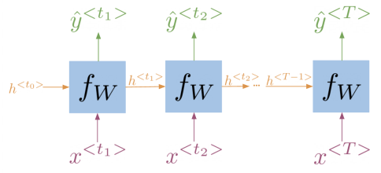
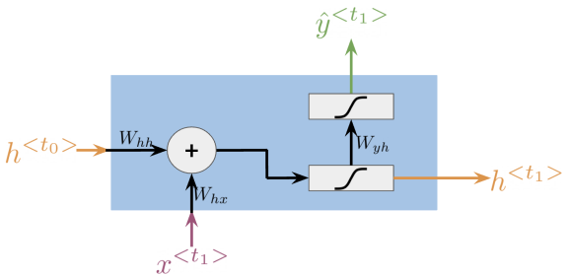
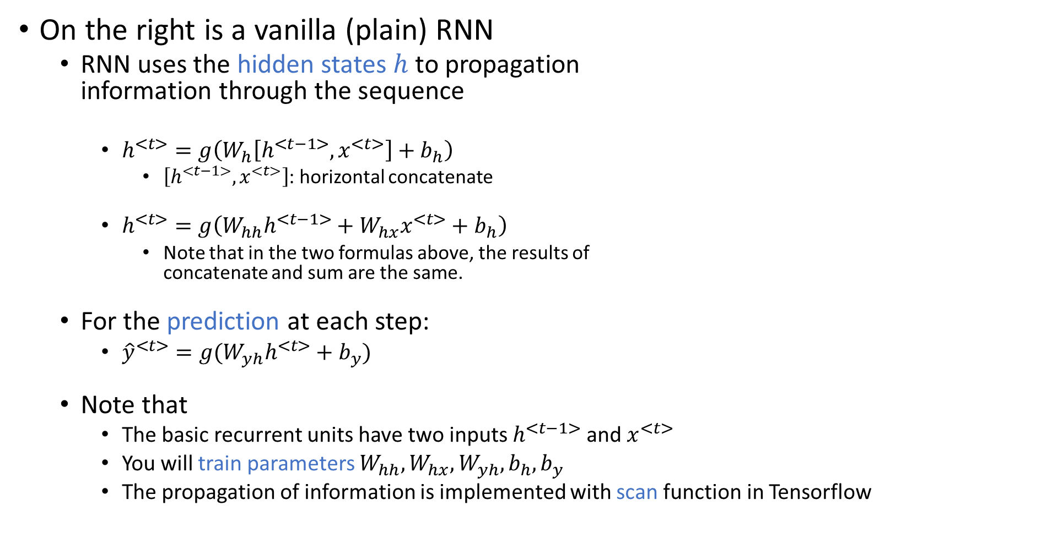
Math in Simple RNN
On the right is a vanilla (plain) RNN
RNN uses the hidden states $h$ to propagation information through the sequence
$h^{<t>}=g\left(W_{h}\left[h^{<t−1>},x^{<t>}\right]+b_{h}\right)$
$\left[h^{<t−1>},x^{<t>}\right]$: horizontal concatenate
$h^{<t>}=g\left(W_{hh}h^{<t−1>}+W_{hx}x^{<t>}+b_{h}\right)$
Note that in the two formulas above, the results of concatenate and sum are the same.
For the prediction at each step:
${\hat{y}}^{<t>}=g(W_{yh}h^{<t>}+b_{y})$
Note that
The basic recurrent units have two inputs $h^{<t−1>}$ and $x^{<t>}$
You will train parameters $W_{hh}, W_{hx}, W_{yh}, b_{h}, b_{y}$
The propagation of information is implemented with scan function in Tensorflow

Slide 5
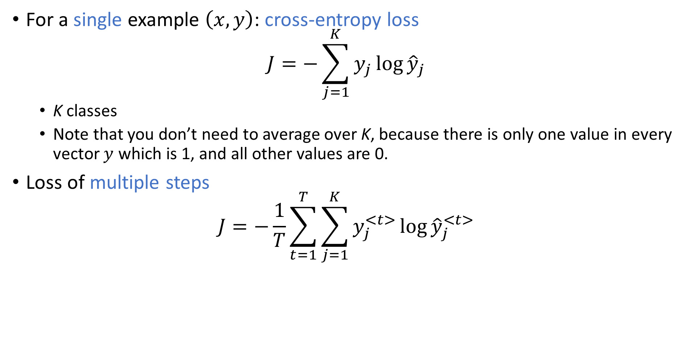
Loss Function for RNNs
For a single example $\left(x,y\right)$: cross-entropy loss $J=−\sum_{j=1}^{K}{y_{j}\log{{\hat{y}}_{j}}}$
K classes
Note that you don’t need to average over K, because there is only one value in every vector $y$ which is 1, and all other values are 0.
Loss of multiple steps $J=−\frac{1}{T}\sum_{t=1}^{T}{\sum_{j=1}^{K}{y_{j}^{<t>}\log{{\hat{y}}_{j}^{<t>}}}}$

Slide 6
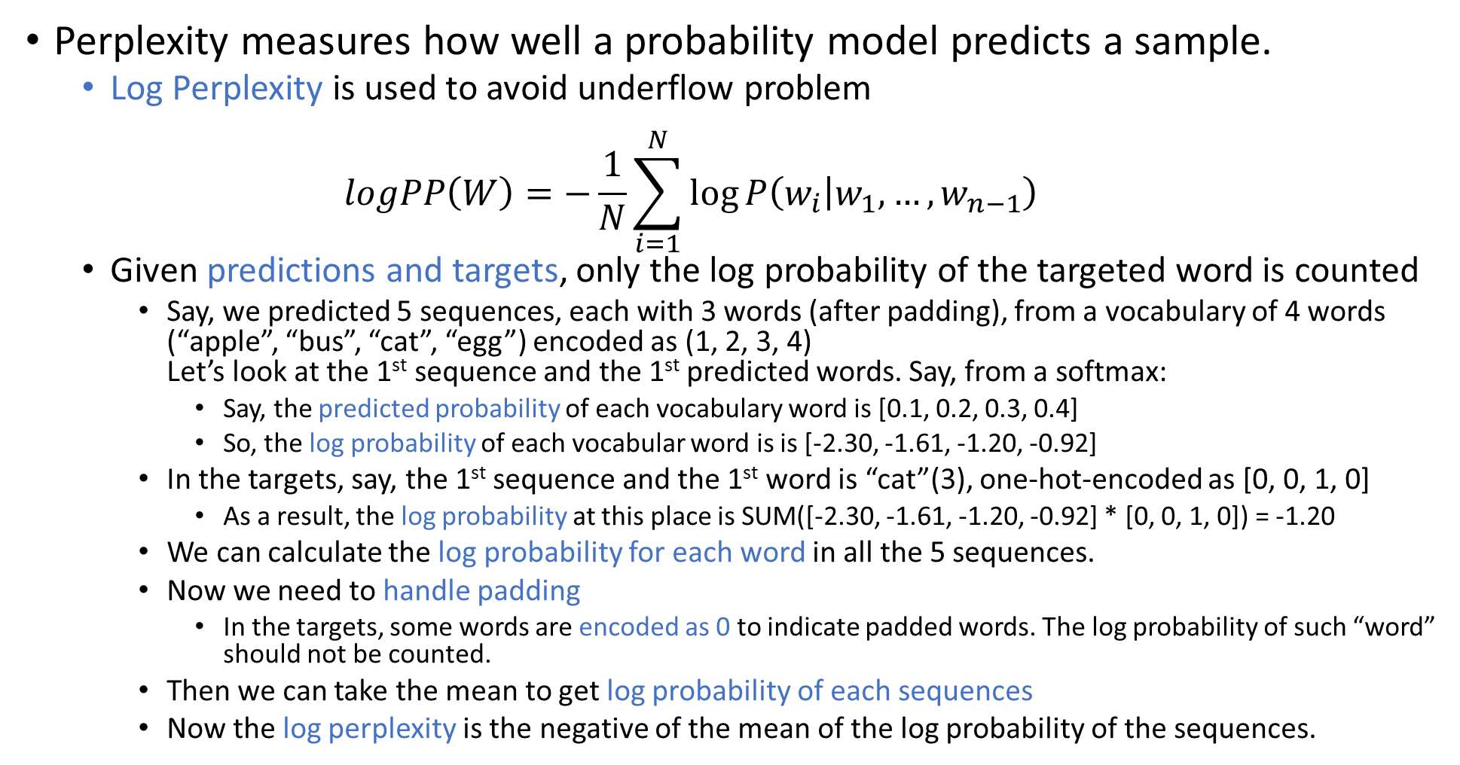
Calculate Perplexity
Perplexity measures how well a probability model predicts a sample.
Log Perplexity is used to avoid underflow problem $logPP\left(W\right)=−\frac{1}{N}\sum_{i=1}^{N}{\log{P\left(w_{i} | w_{1},…,w_{n−1}\right)}}$
Given predictions and targets, only the log probability of the targeted word is counted
Say, we predicted 5 sequences, each with 3 words (after padding), from a vocabulary of 4 words (“apple”, “bus”, “cat”, “egg”) encoded as (1, 2, 3, 4) Let’s look at the 1st sequence and the 1st predicted words. Say, from a softmax:
Say, the predicted probability of each vocabulary word is [0.1, 0.2, 0.3, 0.4]
So, the log probability of each vocabular word is is [-2.30, -1.61, -1.20, -0.92]
In the targets, say, the 1st sequence and the 1st word is “cat”(3), one-hot-encoded as [0, 0, 1, 0]
As a result, the log probability at this place is SUM([-2.30, -1.61, -1.20, -0.92] * [0, 0, 1, 0]) = -1.20
We can calculate the log probability for each word in all the 5 sequences.
Now we need to handle padding
In the targets, some words are encoded as 0 to indicate padded words. The log probability of such “word” should not be counted.
Then we can take the mean to get log probability of each sequences
Now the log perplexity is the negative of the mean of the log probability of the sequences.

Slide 7
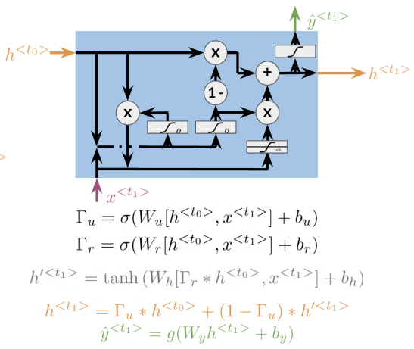
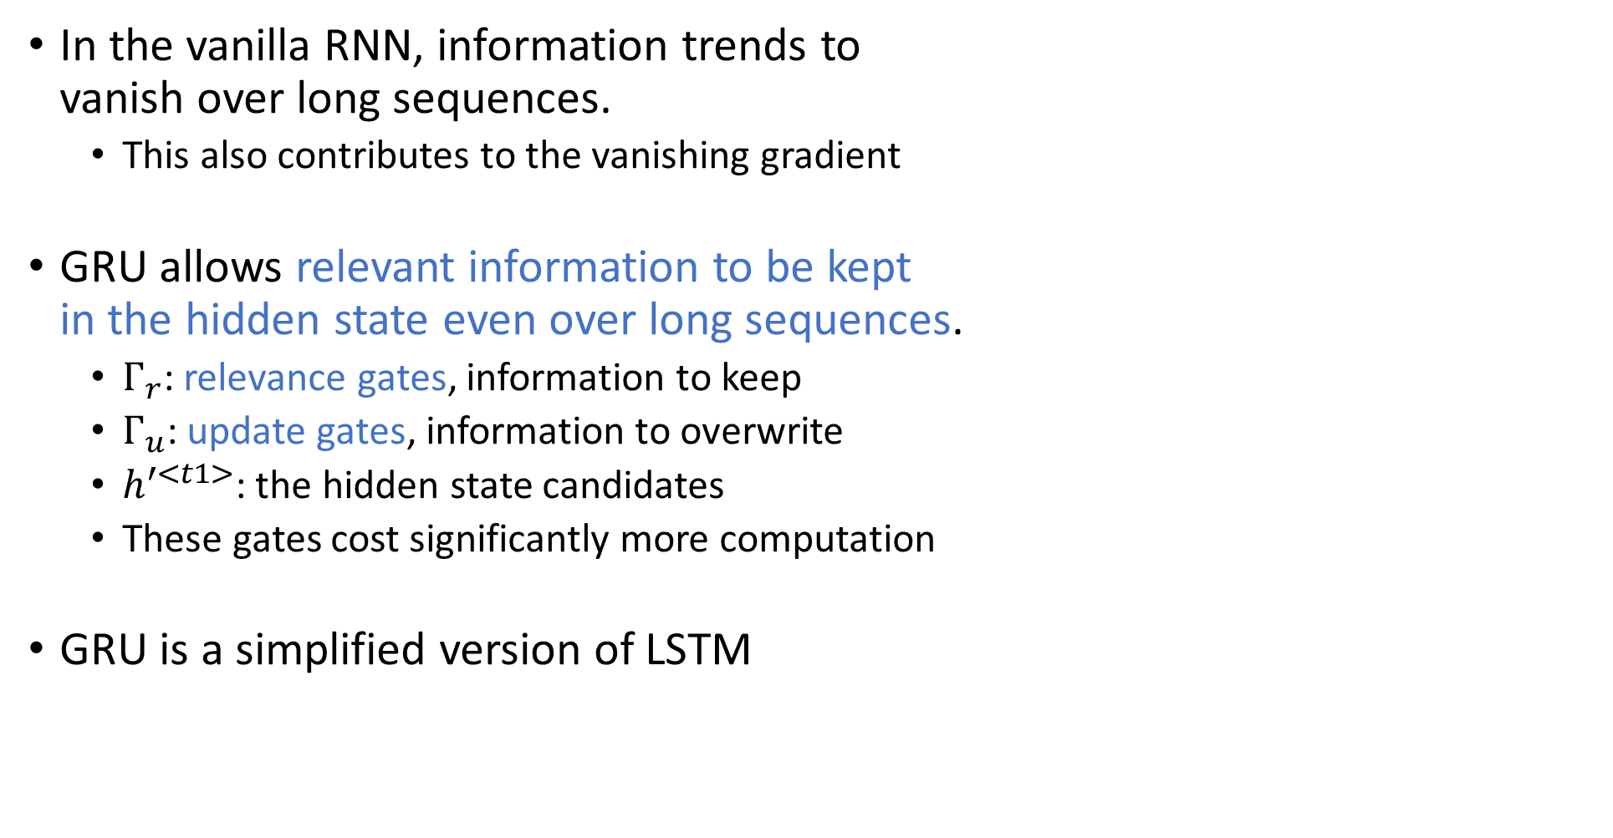



Gated Recurrent Units (GRU)
In the vanilla RNN, information trends to vanish over long sequences.
This also contributes to the vanishing gradient
GRU allows relevant information to be kept in the hidden state even over long sequences.
$Г_{r}$: relevance gates, information to keep
$Г_{u}$: update gates, information to overwrite
$h^{′<t1>}$: the hidden state candidates
These gates cost significantly more computation
GRU is a simplified version of LSTM
$$Г_{r}$$
$$Г_{u}$$
$$h^{′<t1>}$$

Slide 8
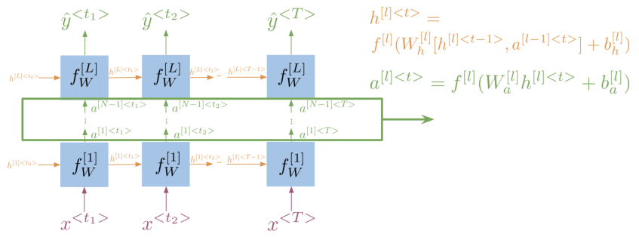

Deep and Bi-directional RNNs
Bi-directional RNN: make use of text before and after each word
Combination of a forward RNN and a backward RNN
Acyclic: the information flows “from the past” and “from the future” independently
Computations from left to right, are completed independent of the computation from right to left
To get predicts $\hat{y}$
Start propagating information from both directions
Once you get both hidden states for a step, you can get ${\hat{y}}^{<t>}=g(W_{y}\left[{\vec{h}}^{<t>},{\overset{⃖}{h}}^{<t>}\right]+b_{y})$
Deep RNN stacks multiple RNNs
Propagate first: Get hidden states for the current layer
Get deeper later: Pass the activations to the next layer
Intermediate layers and activations

Slide 9
Pros and Cons of RNN
Pros of RNN
Captures dependencies within a short range
Takes up less RAM than other n-gram models
Cons of RNN
Struggles to capture long term dependencies
Prone to vanishing or exploding gradients
The computation at early steps has little influence on the later outputs / hidden states
When calculating the gradient of the loss at later steps regarding to early steps, based on the chain rule, it is made of the product of many partial derivatives (all steps in between)
If the partial derivatives < 1, the gradient goes to 0
Vanishing gradient causes the RNN to ignore the values computed at early steps
If the partial derivatives > 1, the gradient goes to infinity
Exploding gradient causes convergence problem during training
Techniques to reduce chance of vanishing / exploding gradient
Identity RNN with ReLU: Initialize weights to the identity matrix
Only works for vanishing gradients
Gradient clipping: cap large gradient to a fixed number, to control exploding gradient
Skip connections: provide a direct connection to earlier layers
Use GRU or LSTM

